Slide 1
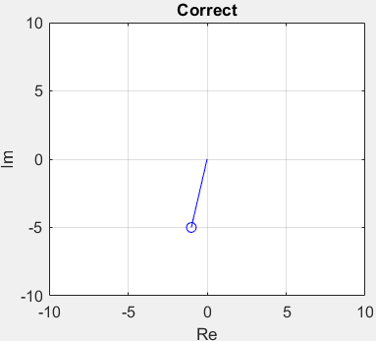
If you are having trouble with the homework, make an appointment to see me even if it is after it is due.
Some Notes
The argument of the exponential, sine and cosine functions must be unitless (radians).
Degrees are a unit, radians are not a unit. Consider circumference of a circle and arc length. $2π$ and $θ$ cannot have units.
Complex exponential representation of a complex number.
$$s=−1−5j→Ce^{jθ}$$
$$C=\left|s\right|=\sqrt{{(−1)}^{2}+{(−5)}^{2}}=\sqrt{26}=5.099$$
$$θ_{b}=\tan^{−1}\left(\frac{−5}{−1}\right)=\tan^{−1}\left(5\right)=1.37$$
$$θ=θ_{b}+π=4.515$$
$$s_{1}=Ce^{jθ_{b}}=1+5j$$
$$s_{2}=Ce^{jθ}=−1−5j$$
$$C=2πR$$
$$R$$
$$d=θR$$
$$R$$
$$d$$
$$θ$$
$$s_{1}=Ce^{jθ_{b}}=1+5j$$
$$θ$$
$$θ_{b}$$
$$s_{2}=Ce^{jθ}=−1−5j$$

Slide 2
Homework 2, Inverse Laplace Transform Node
You may skip this example. The answers on this do not count in your grade.

Slide 3
In Lecture 2, we finished Laplace transforms. Today we will cover the inverse Laplace transform.
Module 1 Goal: Use Laplace transforms to solve differential equations.
Lecture 2 – Inverse Laplace Transfrom
Lecture 3 – Inverse Laplace Transforms
IVT and FVT
Apply Laplace Transform to first and second order linear ordinary differential equations
First Order Example
Second order
General form determines $L^{−1}\left[V\left(s\right)\right]$ and $L^{−1}\left[X\left(s\right)\right]$ to obtain $v\left(t\right)$ and $x\left(t\right)$
Methods to invert first and second order Laplace transforms
Solving Differential Equations with Laplace Transforms
Solving first order differential equations with Laplace transforms
Solving second order differential equations with Laplace transforms (repeated real roots case)
Identifying the graph of the response associated with a differential equation from the Laplace transform
The Laplace transform of the time derivative of a function ($\dot{x}(t)$) was determined using integration by parts
$$L\left[\dot{x}(t)\right]=sX\left(s\right)−x(0)$$
Suppose we define $v\left(t\right)$ to be $\dot{x}(t)$, then …
$$L\left[\dot{v}(t)\right]=sV\left(s\right)−v(0)$$
Now since $V\left(s\right)=L\left[\dot{x}(t)\right]$, we have …
$$L\left[\dot{v}(t)\right]=L\left[\ddot{x}(t)\right]=s\left(sX\left(s\right)−x(0)\right)−v(0)$$
$$L\left[\ddot{x}(t)\right]=s^{2}X\left(s\right)−sx\left(0\right)−\dot{x}(0)$$
A “dot” becomes and $s$
Now we can use this for differential equations
Derivative
Initial Condition
Constant
$$m\dot{v}+bv=mg∙u(t)$$
$$V\left(s\right)=\frac{mg}{s\left(ms+b\right)}−\frac{mv(0)}{ms+b}$$
Zero Root
First Degree Polynomial
Derivatives
Initial Conditions
$$m\ddot{x}+b\dot{x}+kx=0$$
$$X\left(s\right)=\frac{msx\left(0\right)+m\dot{x}\left(0\right)+bx(0)}{ms^{2}+bs+k}$$
First Degree Polynomial
Second Degree Polynomial

Slide 4
So far, we have reviewed
Laplace of a few basic functions:
$$L\left[u(t)\right]=\frac{1}{s},$$
$$L\left[e^{−at}\right]=\frac{1}{s+a},$$
$$L\left[\sin\left(ωt\right)\right]=\frac{ω^{2}}{s^{2}+ω^{2}}$$
The Laplace transform of the time derivative of a function ($\dot{x}(t)$) was determined using integration by parts
$$L\left[\dot{x}(t)\right]=sX\left(s\right)−x(0)$$
$$L\left[\ddot{x}(t)\right]=s^{2}X\left(s\right)−sx\left(0\right)−\dot{x}(0)$$

Slide 5
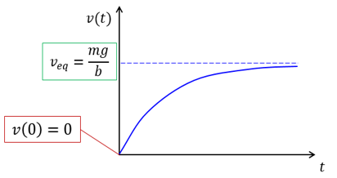
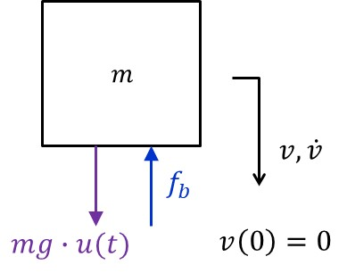
So far, we reviewed
Initial Value Theorem: If the function $x(t)$ is bounded and $\lim_{t→0}{x\left(t\right)}$exists, then the following is true.
$$\lim_{t→0}{x\left(t\right)}=\lim_{s→∞}\left(sX(s)\right)$$
This provides information about the starting point of a time domain function $x(t)$ from its Laplace representation $X\left(s\right).$
Final Value Theorem: If the function $x(t)$ is bounded and $\lim_{t→∞}{x\left(t\right)}$exists, then the following is true.
$$\lim_{t→∞}{x\left(t\right)}=\lim_{s→0}\left(sX(s)\right)$$
This provides information about the ending point of a time domain function $x(t)$ from its Laplace representation $X\left(s\right).$
Final Value Theorem
$$V\left(s\right)=\frac{mg}{\left.s(ms+b\right)}$$
Initial Value Theorem
$$v\left(0\right)=\lim_{t→0}{v\left(t\right)}=\lim_{s→∞}\left(sV(s)\right)=\lim_{s→∞}\left(sV(s)\right)$$
$$=\lim_{s→∞}\left(s\frac{mg}{\left.s(ms+b\right)}\right)=\lim_{s→∞}\left(\frac{mg}{ms+…}\right)=0$$
$$v_{eq}=\lim_{t→∞}{v\left(t\right)}=\lim_{s→0}\left(sV(s)\right)$$
$$=\lim_{s→0}\left(s\frac{mg}{\left.s(ms+b\right)}\right)=\frac{mg}{b}$$

Slide 6
Today, we will review
Using partial Fraction Expansion to simplify a Laplace representation so that an Inverse Laplace operation can be implemented.
First-order system
Second-order system
$$m\dot{v}+bv=mg∙u(t)$$
$$V\left(s\right)=\frac{mg}{s\left(ms+b\right)}−\frac{mv(0)}{ms+b}$$
$$m\ddot{x}+b\dot{x}+kx=0$$
$$X\left(s\right)=\frac{msx\left(0\right)+m\dot{x}\left(0\right)+bx(0)}{ms^{2}+bs+k}$$

Slide 7
The Laplace transform is applied to linear ODEs, the solution is obtained algebraically in the Laplace domain and then the time domain solution is obtained with the inverse Laplace transform.
First Order Linear ODEs Lead to Laplace Functions of the Following Form
$$V\left(s\right)=\frac{C_{0}}{D_{1}s+D_{0}}=\frac{C_{0}}{D_{1}}\left(\frac{1}{s+D_{0}/D_{1}}\right)$$
Second Order Linear ODEs Lead to Laplace Functions of the Following Form
$$X\left(s\right)=\frac{C_{1}s+C_{0}}{D_{2}s^{2}+D_{1}s+D_{0}}=\frac{C(s)}{D(s)}$$
The Roots of the denominator polynomial $D\left(s\right)=D_{2}s^{2}+D_{1}s+D_{0}$ determine the most efficient method to invert the Laplace transform and the form of the solution (oscillatory or exponential).
Use Entry 6

Slide 8
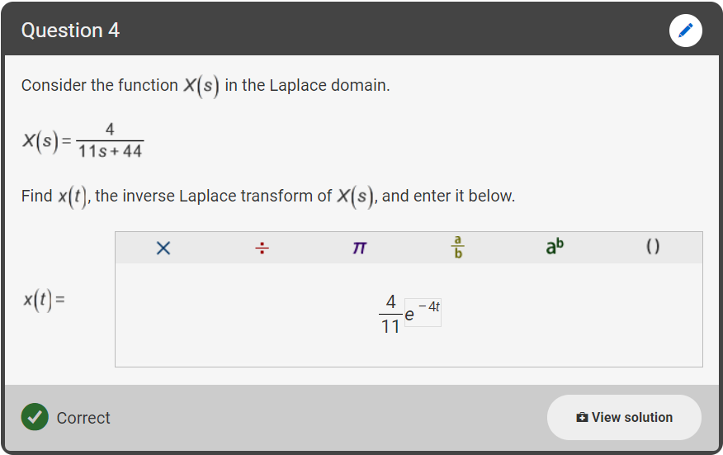
Step 1: Factor out the 4 in the numerator and the 11 in the denominator.
$$X\left(s\right)=\frac{4}{11s+44}=\frac{4}{11}\left(\frac{1}{s+4}\right)$$
Step 2: Use linearity of the inverse Laplace transform.
$$x\left(t\right)=L^{−1}\left[\frac{4}{11}\left(\frac{1}{s+4}\right)\right]=\frac{4}{11}L^{−1}\left[\frac{1}{s+4}\right]$$
Step 3: Use table entry 6 in the Laplace transform table.
$$x\left(t\right)=\frac{4}{11}e^{−4t}$$
Comment: Suppose $X\left(s\right)=\frac{4}{11s−44}=\frac{4}{11}\left(\frac{1}{s−4}\right)$. The solution is UNBOUNDED.
x$\left(t\right)=\frac{4}{11}e^{+4t}$
Comment: Suppose $X\left(s\right)=\frac{4}{s\left(11s+44\right)}=\frac{4}{11}\left(\frac{1}{s\left(s+4\right)}\right)$. Use table entry
$$x\left(t\right)=\frac{1}{11}\left(1−e^{−4t}\right)$$

Slide 9
For second order denominator polynomials $D(s)$, the roots of the denominator polynomial determine the form of the inverse transform.
Second Order Problem
$$X\left(s\right)=\frac{C_{1}s+C_{2}}{D_{1}s^{2}+D_{2}s{+D}_{3}}$$
The denominator polynomial is $D\left(s\right)=D_{1}s^{2}+D_{2}s{+D}_{3}$. There are three possibilities.
Real Distinct Roots $s_{1,2}=−a, −c$. Partial fractions expansion and entry 6.
$X\left(s\right)=\frac{C_{1}s+C_{2}}{D_{1}s^{2}+D_{2}s{+D}_{3}}=\frac{C_{1}}{D_{1}}\left(\frac{s+C_{2}/C_{1}}{(s+a)(s+c)}\right)=\frac{a_{1}}{s+a}+\frac{a_{2}}{s+c}$
Real Repeated Roots $s_{1,2}=−a, −a$. Partial fractions expansion and entries 6 and 7.
$X\left(s\right)=\frac{C_{1}s+C_{2}}{D_{1}s^{2}+D_{2}s{+D}_{3}}=\frac{C_{1}}{D_{1}}\left(\frac{s+C_{2}/C_{1}}{{(s+a)}^{2} }\right)=\frac{a_{1}}{s+a}+\frac{a_{2}}{{\left(s+a\right)}^{2}}$
Complex Roots $s_{1,2}=−a±jω$. Complete the square and use entries 20 and 21.
$X\left(s\right)=\frac{C_{1}s+C_{2}}{D_{1}s^{2}+D_{2}s{+D}_{3}}=\frac{C_{1}}{D_{1}}\left(\frac{s+C_{2}/C_{1}}{{(s+a)}^{2}+ω^{2}}\right)$

Slide 10
For second order denominator polynomials $D(s)$, the roots of the denominator polynomial determine the form of the inverse transform.
Second Order Problem
$$X\left(s\right)=\frac{C_{1}s+C_{2}}{D_{1}s^{2}+D_{2}s{+D}_{3}}=\frac{C(s)}{D(s)}$$
The denominator polynomial is $D\left(s\right)=D_{1}s^{2}+D_{2}s{+D}_{3}$. There are three possibilities.
Real Distinct Roots $s_{1,2}=−a, −c$. Partial fractions expansion and entry 6.
$X\left(s\right)=\frac{C_{1}s+C_{2}}{D_{1}s^{2}+D_{2}s{+D}_{3}}=\frac{C_{1}}{D_{1}}\left(\frac{s+C_{2}/C_{1}}{(s+a)(s+c)}\right)=\frac{a_{1}}{s+a}+\frac{a_{2}}{s+c}$
Real Repeated Roots $s_{1,2}=−a, −a$. Partial fractions expansion and entries 6 and 7.
$X\left(s\right)=\frac{C_{1}s+C_{2}}{D_{1}s^{2}+D_{2}s{+D}_{3}}=\frac{C_{1}}{D_{1}}\left(\frac{s+C_{2}/C_{1}}{{(s+a)}^{2} }\right)=\frac{a_{1}}{s+a}+\frac{a_{2}}{{\left(s+a\right)}^{2}}$
Complex Roots $s_{1,2}=−a±jω$. Complete the square and use entries 20 and 21.
$X\left(s\right)=\frac{C_{1}s+C_{2}}{D_{1}s^{2}+D_{2}s{+D}_{3}}=\frac{C_{1}}{D_{1}}\left(\frac{s+C_{2}/C_{1}}{{(s+a)}^{2}+ω^{2}}\right)$
Partial Fractions
Partial Fractions
Complete Square

Slide 11
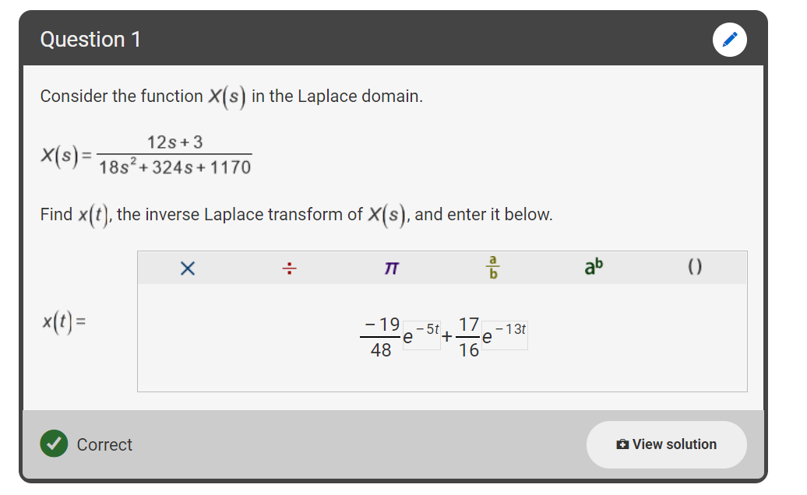
Step 1: Factor out the 12 in the numerator and the 18 in the denominator.
$$X\left(s\right)=\frac{12s+3}{18s^{2}+324s+1170}=\frac{2}{3}\left(\frac{s+\frac{1}{4}}{s^{2}+18s+65}\right)$$
Step 2: Find the roots of the denominator.
$$s^{2}+18s+65=0$$
$$s_{1,2}=\frac{−18±\sqrt{{\left(18\right)}^{2}−4(1)(65)}}{2(1)}=\frac{−18±\sqrt{324−260}}{2(1)}$$
$$s_{1,2}=\frac{−18±\sqrt{64}}{2(1)}=\frac{−18±8}{2(1)}=−5, −13$$
Step 3: Factor and complete a partial fractions expansion.
$$\frac{s+1/4}{s^{2}+18s+65}=\frac{s+1/4}{(s+5)(s+13)}=\frac{a_{1}}{s+5}+\frac{a_{2}}{s+13}$$
Step 4: Find $a_{1}$ and $a_{2}$ by multiplying through by the denominator and strategically choosing values for s.
$\lim_{s→−5}\left[s+1/4=a_{1}(s+13) +a_{2}(s+5)\right]→−\frac{19}{4}=a_{1}(8)→a_{1}$=$−\frac{19}{32}$
$$s+1/4=a_{1}(s+13) +a_{2}(s+5)$$
$\lim_{s→−13}\left[s+1/4=a_{1}(s+13) +a_{2}(s+5)\right]→−\frac{51}{4}=a_{2}(−8)→a_{2}$=$\frac{51}{32}$
Note that since $s$ is a variable, the values of $a_{1}$ and $a_{2}$ must be consistent with any values of $s$. Thus we can choose $s$ to aid in finding $a_{1}$ and $a_{2}$.

Slide 12
Step 5: Put in $a_{1}$ and $a_{2}$.
$$X\left(s\right)=\frac{2}{3}\left(\frac{s+1/4}{s^{2}+18s+65}\right)$$
$$X(s)=\frac{2}{3}\left(−\frac{19}{32}\left(\frac{1}{s+5}\right)+\frac{51}{32}\left(\frac{1}{s+13}\right)\right)$$
$$X(s)=−\frac{19}{48}\left(\frac{1}{s+5}\right)+\frac{51}{48}\left(\frac{1}{s+13}\right)$$
Step 6: Apply table entry 6 to both terms and simplify 51/48 to 17/16.
$$X(s)=−\frac{19}{48}\left(\frac{1}{s+5}\right)+\frac{17}{16}\left(\frac{1}{s+13}\right)$$
$$x(t)=−\frac{19}{48}e^{−5t}+\frac{17}{16}e^{−13t}$$
Enter the answers in fractional form. We have worked to be sure that these all come out with even numbers and relatively simple fractions.
Real roots of $D\left(s\right)$ lead to and exponential, non-oscillatory time domain function. This behavior will be called overdamped.

Slide 13
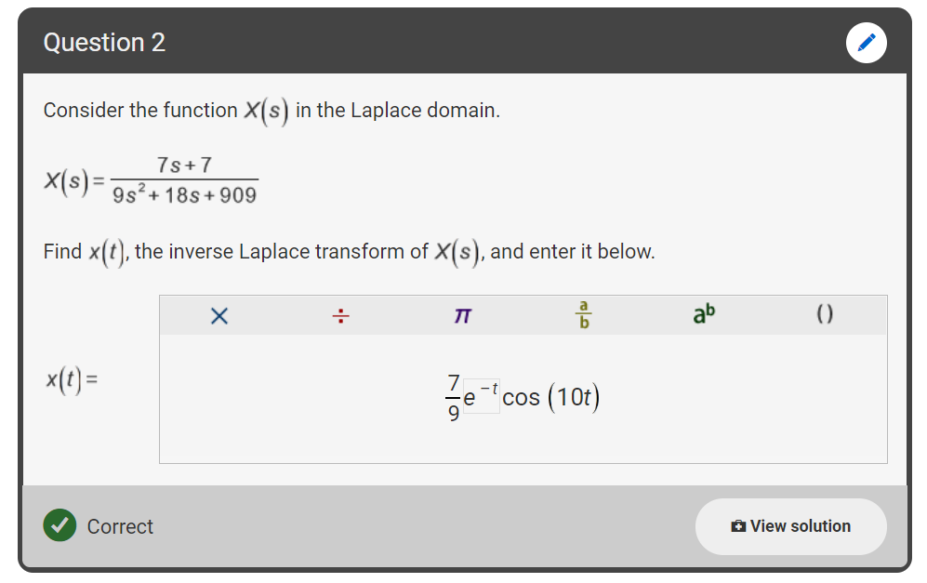
Step 1: Factor out the 7 in the numerator and the 9 in the denominator.
$$X\left(s\right)=\frac{7s+7}{9s^{2}+18s+909}=\frac{7}{9}\left(\frac{s+1}{s^{2}+2s+101}\right)$$
Step 2: Find the roots of the denominator.
$$s^{2}+2s+101=0$$
$$s_{1,2}=\frac{−2±\sqrt{{\left(2\right)}^{2}−4(1)(101)}}{2(1)}=\frac{−2±\sqrt{4−404}}{2(1)}$$
$$s_{1,2}=\frac{−2±\sqrt{−400}}{2(1)}=\frac{−2±20j}{2(1)}=−1±10j$$
Step 3: Complete the square in the denominator.
$$X\left(s\right)=\frac{7}{9}\left(\frac{s+1}{s^{2}+2s+1−1+101}\right)=\frac{7}{9}\left(\frac{s+1}{{\left(s+1\right)}^{2}+100}\right)=\frac{7}{9}\left(\frac{s+1}{{\left(s+1\right)}^{2}+{\left(10\right)}^{2}}\right)$$
Step 4: Use table entry 21.
$$X\left(s\right)=\frac{7}{9}\left(\frac{s+1}{{\left(s+1\right)}^{2}+{\left(10\right)}^{2}}\right)$$
$$X\left(s\right)=\frac{7}{9}e^{−t}\cos\left(10t\right)$$
Complex roots of $D\left(s\right)$ lead to a decaying oscillatory time domain function. This behavior will be called underdamped.

Slide 14
For second order denominator polynomials $D(s)$, the roots of the denominator polynomial determine the form of the inverse transform.
Second Order Problem
$$X\left(s\right)=\frac{C_{1}s+C_{2}}{D_{1}s^{2}+D_{2}s{+D}_{3}}=\frac{C(s)}{D(s)}$$
The denominator polynomial is $D\left(s\right)=D_{1}s^{2}+D_{2}s{+D}_{3}$. There are three possibilities.
Real Distinct Roots $s_{1,2}=−a, −c$. Partial fractions expansion and entry 6.
$X\left(s\right)=\frac{C_{1}s+C_{2}}{D_{1}s^{2}+D_{2}s{+D}_{3}}=\frac{C_{1}}{D_{1}}\left(\frac{s+C_{2}/C_{1}}{(s+a)(s+c)}\right)=\frac{A_{1}}{s+a}+\frac{A_{2}}{s+c}$
Real Repeated Roots $s_{1,2}=−a, −a$. Partial fractions expansion and entries 6 and 7.
$X\left(s\right)=\frac{C_{1}s+C_{2}}{D_{1}s^{2}+D_{2}s{+D}_{3}}=\frac{C_{1}}{D_{1}}\left(\frac{s+C_{2}/C_{1}}{{(s+a)}^{2} }\right)=\frac{A_{1}}{s+a}+\frac{A_{2}}{{\left(s+a\right)}^{2}}$
Complex Roots $s_{1,2}=−a±jω$. Complete the square and use entries 20 and 21.
$X\left(s\right)=\frac{C_{1}s+C_{2}}{D_{1}s^{2}+D_{2}s{+D}_{3}}=\frac{C_{1}}{D_{1}}\left(\frac{s+C_{2}/C_{1}}{{(s+a)}^{2}+ω^{2}}\right)$
Fourth Common Possibility: Third order case (step input)
$X\left(s\right)=\frac{C_{1}s+C_{2}}{s\left(D_{1}s^{2}+D_{2}s{+D}_{3}\right)}=\frac{A_{1}}{s}+\frac{A_{2}s+A_{3}}{D_{1}s^{2}+D_{2}s{+D}_{3}}$
Partial Fractions
Partial Fractions
Complete Square
Treat this as above

Slide 15
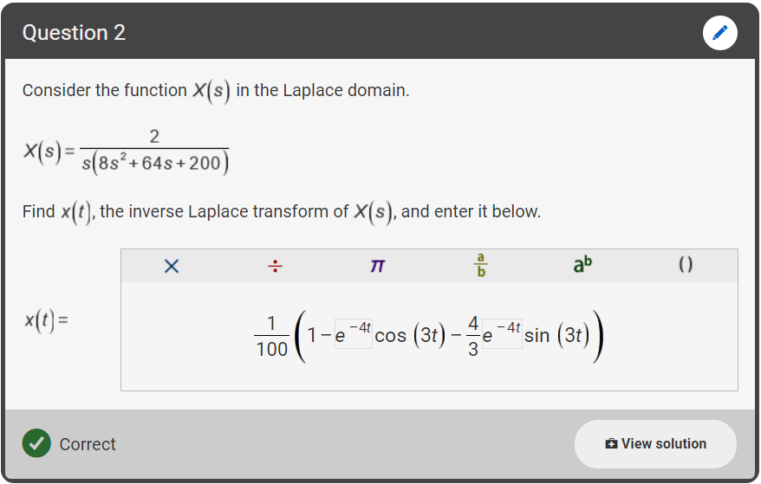
Step 1: Factor out the 2 in the numerator and the 8 in the denominator.
$$X\left(s\right)=\frac{2}{s\left(8s^{2}+64s+200\right)}$$
$$=\frac{1}{4}\left(\frac{1}{s\left(s^{2}+8s+25\right)}\right)$$
Step 2: Use an alternate partial fractions expansion.
$$\frac{1}{s\left(s^{2}+8s+25\right)}=\frac{A_{1}}{s}+\frac{A_{2}s+A_{3}}{s^{2}+8s+25}$$
Step 3: Multiply by the denominator.
$$1=A_{1}\left(s^{2}+8s+25\right)+A_{2}s^{2}+A_{3}s$$
Step 4: Group terms with like powers of $s$.
$$1=A_{1}s^{2}+8A_{1}s+25A_{1}+A_{2}s^{2}+A_{3}s$$
$$0=\left(A_{1}+A_{2}\right)s^{2}+\left(8A_{1}+A_{3}\right)s+\left(25A_{1}−1\right)s^{0}$$
Step 5: Recognize that the coefficient of each power of $s$ must be zero.
$$A_{1}+A_{2}=0$$
$$A_{2}=−A_{1}$$
$$A_{2}=−\frac{1}{25}$$
$$8A_{1}+A_{3}=0$$
$$A_{3}=−8A_{1}$$
$$A_{3}=−\frac{8}{25}$$
$$25A_{1}−1=0$$
$$25A_{1}=1$$
$$A_{1}=\frac{1}{25}$$

Slide 16
Step 6: Write the expansion.
$$X\left(s\right)=\frac{1}{4}\left(\frac{1}{s\left(s^{2}+8s+25\right)}\right)$$
$$X\left(s\right)=\frac{1}{4}\left(\frac{1}{25}\left(\frac{1}{s}\right)−\frac{1}{25}\left(\frac{s+8}{s^{2}+8s+25}\right)\right)$$
Step 7: Find the roots of the denominator of the second term.
$$s^{2}+8s+25=0$$
$$s_{1,2}=\frac{−8±\sqrt{{\left(8\right)}^{2}−4(1)(25)}}{2(1)}=\frac{−8±\sqrt{−36}}{2(1)}=−4±3j$$
Step 8: Complete the square in the second term and break up to match entries 20 and 21.
$$X\left(s\right)=\frac{1}{100}\left(\frac{1}{s}−\frac{s+8}{s^{2}+8s+16−16+25}\right)=\frac{1}{100}\left(\frac{1}{s}−\frac{s+8}{{\left(s+4\right)}^{2}+9}\right)$$
$$X\left(s\right)=\frac{1}{100}\left(\frac{1}{s}−\frac{s+4+4}{{\left(s+4\right)}^{2}+3^{2}}\right)=\frac{1}{100}\left(\frac{1}{s}−\frac{s+4}{{\left(s+4\right)}^{2}+3^{2}}−\frac{1}{3}\frac{4(3)}{{\left(s+4\right)}^{2}+3^{2}}\right)$$
$$x\left(t\right)=\frac{1}{100}\left(u\left(t\right)−e^{−4t}\cos\left(3t\right)−\frac{4}{9}e^{−4t}\sin\left(3t\right)\right)$$
$$x\left(t\right)=\frac{1}{100}\left(1−e^{−4t}\cos\left(3t\right)−\frac{4}{3}e^{−4t}\sin\left(3t\right)\right)$$

Slide 17
The main points of Lecture 3 are given.
Goal: Use Laplace transforms to solve linear first and second order ordinary differential equations.
The Laplace transform allows a differential equation in the time domain to be interpreted as algebraic equations in the Laplace domain.
The Laplace transform of the time derivative of a function naturally leads to solutions in the Laplace domain that consist of ratios of polynomials in $s$.
First order linear ODEs Second order linear ODEs
The inverse Laplace transform allows the Laplace domain functions to be written in the time domain.
The roots of the denominator of the Laplace domain function determine the most efficient way to invert the Laplace transform and more importantly determines the mathematical behavior of the response.
If the roots have negative real part, the solution will be bounded.
First order linear ODEs lead with no sustained input lead to exponential solutions only.
Second order linear ODEs can lead to exponential or damped exponential solutions.
Distinct real roots – exponential, non-oscillatory, overdamped ($e^{−at}$)
Repeated real roots – exponential, non-oscillatory, critically damped ($e^{−at}$, ${te}^{−at}$)
Complex roots – damped sinusoidal, oscillatory, underdamped ($e^{−at}\sin\left(ωt\right)$, $e^{−at}\cos\left(ωt\right)$)
$$V\left(s\right)=\frac{C_{0}}{D_{1}s+D_{0}}$$
$$X\left(s\right)=\frac{C_{1}s+C_{2}}{D_{1}s^{2}+D_{2}s{+D}_{3}}=\frac{C(s)}{D(s)}$$

Slide 18
Partial Fraction Expansion
When using Laplace to solve LTI ODEs, the solution to the ODE in the Laplace domain is a ratio of polynomials in s.
Let $\hat{q}=N(s)/D\left(s\right)$ where $N\left(s\right)$ and $D\left(s\right)$ are polynomials in $s.$
Partial fraction expansion helps to solve for
We write
where $z_{i}$ and $p_{i}$ are complex numbers.

Slide 19
The main points of Lecture 2 are given.
Goal: Use Laplace transforms to solve linear first and second order ordinary differential equations.
Laplace transform tables summarize the Laplace transform of many common functions.
The properties of Laplace transforms used in conjunction with the tables allow us to find the Laplace transforms of many other functions.
For this course, the Laplace transform table it sufficient to all that we do.
The Initial Value Theorem (IVT) and Final Value Theorem (FVT) allow us to deduce the behavior of a time domain function $x\left(t\right)$ from its Laplace domain representation $X(s)$.
The Laplace transform of the time derivative of a function naturally leads to solutions in the Laplace domain that consist of ratios of polynomials in $s$.
First order linear ODEs Second order linear ODEs
First order systems lead to exponential solutions.
Second order systems lead to exponential solutions if the roots of $D(s)$ are real and distinct and lead to exponentially decaying oscillatory solutions if the roots of $D(s)$ are complex.
$$V\left(s\right)=\frac{C_{0}}{D_{1}s+D_{0}}$$
$$X\left(s\right)=\frac{C_{1}s+C_{2}}{D_{1}s^{2}+D_{2}s{+D}_{3}}=\frac{C(s)}{D(s)}$$

Slide 20
Some notes…
If $n=m$, then N(s$)/D(s)$ is exactly proper.
If $n>m$, then N(s$)/D(s)$ is strictly proper.
Roots of N(s$)$ are $z_{1}, z_{2},…z_{m}$. They are called zeros.
Roots of D(s$)$ are $p_{1}, p_{2},…p_{n}$. They are called poles.

Slide 21
Case #1: All roots are separate.
$k_{0}=N_{m}$ if n=m or $k_{0}=0$ if m<n. $k_{0}$, $k_{1}, …k_{n}$are called residues.
How do we solve for the residues?
Example 5: What is the partial fraction expansion of ?

Slide 22
Find $k_{0}$: $k_{0}=0$because m=1<n=2
Find $k_{1}$: Multiply (1) by $s+1$ and evaluate at $s=−1$
Find $k_{2}$: Multiply by $s+5$ and evaluate at $s=−5$

Slide 23
What if some roots are complex?
Example 6: What is s the partial fraction expansion of
Solution
Find $k_{0}$: $k_{0}=N_{m}$because n=m=3
Find $k_{1}$: Multiply by $s+4$ and evaluate at $s=−4$

Slide 24
Find $k_{2} :$Multiply (1) by $s+2−j$and evaluate at $s=−2+j$
Find $k_{3} :$Multiply (1) by $s+2+j$and evaluate at $s=−2−j$
Therefore,
Simplification

Slide 25
To find $L^{−1}\{\hat{q}(s)\}$ note that
$$q(t)$$ | $$\hat{q}(s)$$
$$δ(t)$$ | $$1$$
$$U(t)$$ | $$\frac{1}{s}$$
$$e^{−at}$$ | $$\frac{1}{s+a}$$
$$\sin{ωt}$$ | $$\frac{ω}{s^{2}+ω^{2}}$$
$$\cos{ωt}$$ | $$\frac{1}{s^{2}+ω^{2}}$$
$$t$$ | $$\frac{1}{s^{2}}$$
$$t^{n}$$ | $$\frac{n!}{s^{n+1}}$$
Then,

Slide 26
Case #2- $D(s)$ has repeated roots
where $l_{1}+l_{2}+…+l_{q}$. The partial fraction expansion is given by
Example7: What is the partial fraction expansion of

Slide 27
Find $k_{0}:k_{0}=0$ because $n=3>m=2$.
Find $k_{1}$: Multiply (1) by $s+2$ and evaluate at $s=−2$.
Find $k_{2}:$ Multiply (1) by ${(s+1)}^{2}$.
Evaluate (2) at $s=−1$.

Slide 28
Find $k_{3}$: Differentiate (2) with respect to $s$.
Evaluate at $s=−1$
Therefore,

Slide 29
To find $L^{−1}\{\hat{q}(s)\}$ note that
$$q(t)$$ | $$\hat{q}(s)$$
$$δ(t)$$ | $$1$$
$$U(t)$$ | $$\frac{1}{s}$$
$$e^{−at}$$ | $$\frac{1}{s+a}$$
$$\sin{ωt}$$ | $$\frac{ω}{s^{2}+ω^{2}}$$
$$\cos{ωt}$$ | $$\frac{1}{s^{2}+ω^{2}}$$
$$t$$ | $$\frac{1}{s^{2}}$$
$$t^{n}$$ | $$\frac{n!}{s^{n+1}}$$
Thus,

